Slide 1
Shell Bootcamp 2024 4 Reflections for Week 2
Neha Ann Shygen
Date : 06-September-2024

Slide 2

About Me
My motto in life is to learn and upskill myself, dream big and achieve big.

Slide 3

My learnings from this week!

Slide 4
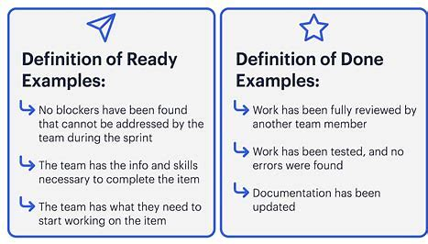
Learning 1 | Definition of Ready and Definition of Done
Definition of Ready (DOR):
User Story descriptions are clear, estimated and understood by every team member, ready to be taken by development team, story must have clear business value, story needs at least one acceptance criteria.
Definition of Done (DOD):
Automated tests are written and all tests are green, code is refractored and reviewed, code is integrated with master branch and deployed to staging environment, UAT is done and the code is ready to be released.

Slide 5
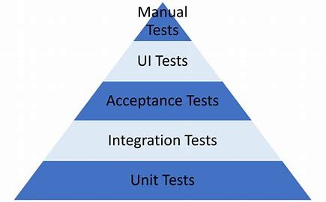
Learning 2 | Software testing types
Functional Testing: all functionalities are tested.
Non-functional Testing: Load testing, response time testing, GUI testing.
White box testing: by developers who have complete information of the architecture and input and output.
Black-box testing: done by QA engineers who don’t have any idea of the internal architecture but knows the input and output.
Grey-box testing: done by automation engineers who know the input and output and the partial internal architecture.
Green-box testing: done by business users

Slide 6
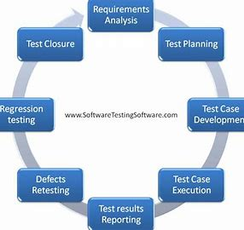
Learning 3 | Software Testing life cycle
Requirement Analysis
Test planning
Test case development
Environment setup
Test execution
Test cycle closure

Slide 7
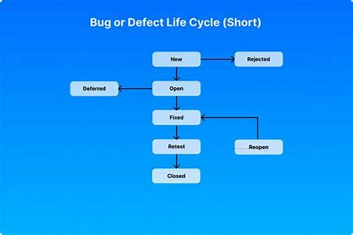
Learning 4 | Bug life cycle and Bug Report
Bug Report contains:
Description of bug
Steps to reproduce
Time stamp
Severity
Priority
Assignee
Screenshot/Recording

Slide 8

Relevance of learnings for my organization

Slide 9
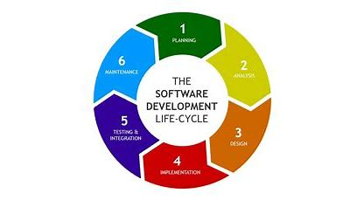
Learning 1 | Definition of Ready and Definition of Done
How I feel Shell implements this learning
DOR and DOD needs to be implemented in every project team of a company to ensure successful completion of the project.
How I feel Shell benefits from this learning
This ensures that the timelines are met and the client is satisfied with the performance.

Slide 10
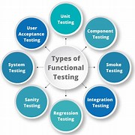
Learning 2 | Software testing types
How I feel Shell implements this learning
Shell uses different types of testing in every team, smoke testing, regression testing etc.
How I feel Shell benefits from this learning
Implementing these types of testing ensures that all defects are addressed and cleared.

Slide 11
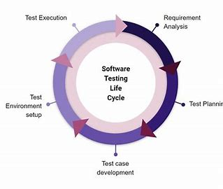
Learning 3 | Software Testing life cycle
How I feel Shell implements this learning
Every team implements this learning to perform test-driven development.
How I feel Shell benefits from this learning
Majority of the defects are addressed before development so as to avoid serious changes to code at a later stage.

Slide 12
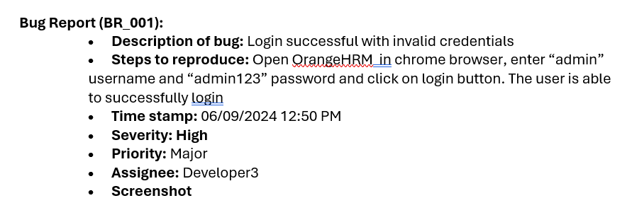
Learning 4 |Bug life cycle and Bug Report
How I feel Shell implements this learning
Shell uses Agile model and designs a bug report for every defect found.
How I feel Shell benefits from this learning
Shell can prioritize and fix the bugs as per requirement so that the project does not suffer any major setback.

Slide 13

Challenges in implementing learning

Slide 14
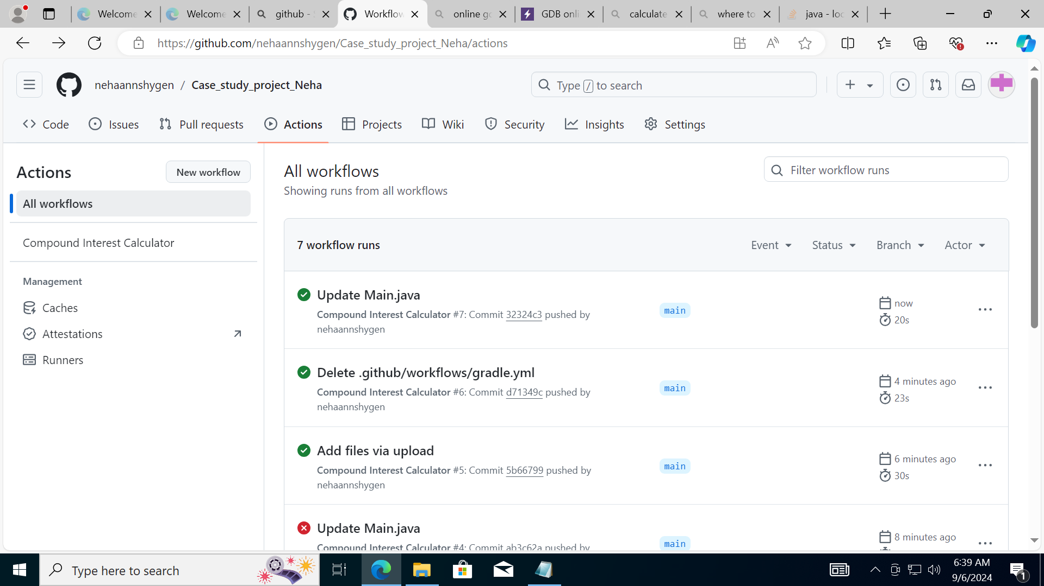
Challenge faced while implementing Learning 1
What were the challenges I faced while implementing Learning 1 and my plan to overcome them
Using GitHub actions to implement CI/CD was a challenge.
Overcame by using a pom.xml file which rendered in a successful build.

Slide 15
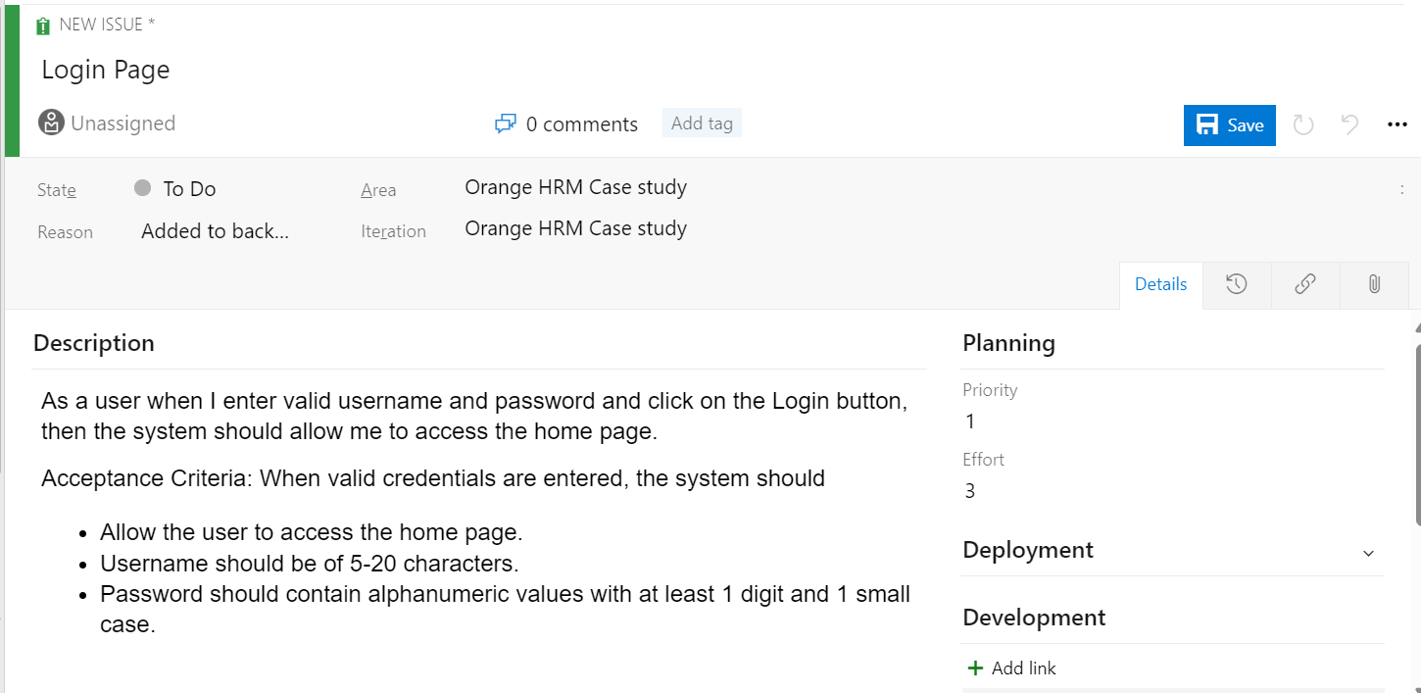
Challenge faced while implementing Learning 2
What were the challenges I faced while implementing Learning 2 and my plan to overcome them
Designing user stories and test cases to perfection.
Overcame by paying attention to the detail and adding every single detail.

Slide 16
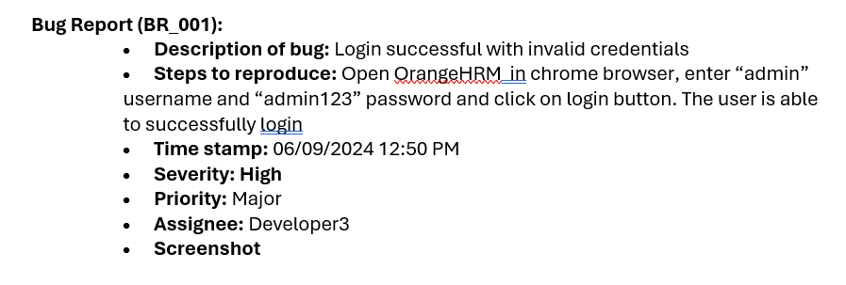
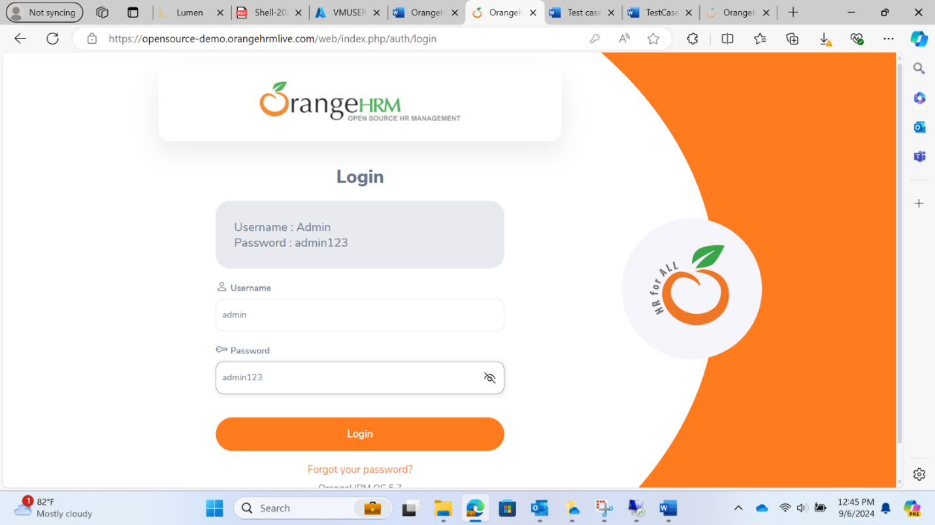
Challenge faced while implementing Learning 3
What were the challenges I faced while implementing Learning 3 and my plan to overcome them
Testing every single testcase led to the discovery of bugs in the application.
Each bug was documented clearly with all steps mentioning how to reproduce the bug.

Slide 17

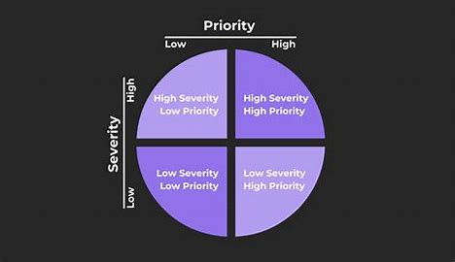
Challenge faced while implementing Learning 4
What were the challenges I faced while implementing Learning 4 and my plan to overcome them
Deciding the priority and severity of the bug was a challenge.
Overcame by paying attention to the business significance of the bug.

Slide 18

Action Plan

Slide 19
My Action Plan for this Week
Actions
Timeline
Status
Understanding and implementiong these topics:
Test cases
Azure VM
CI/CD pipeline using Github Actions
This week
Thorough understanding of these concepts and implemented a case study connecting all these topics.

Slide 20

Learning is also Fun!

Slide 21
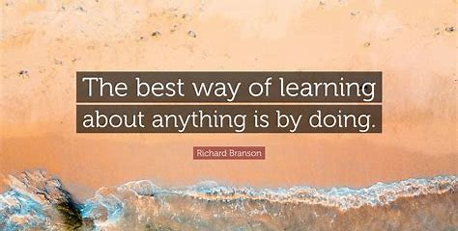
Learning is also Fun!
The learnings for this week was very knowledgeable. This week’s sessions have taught me a lot of things and I gained a lot of knowledge.

Slide 22

Summary
SDLC, STLC
Bug Report
Software Testing
Topics for next week: Frontend Development, .NET/C#, Application Security and Experience Design.

Slide 23
Thank You

